Slide 1


Evaluating the Impact of Experimental Assumptions in Automated Fault Localization
Talk @ ICSE 2023 | Technical Track
Melbourne, Australia | May 17th, 2023
Ezekiel Soremekun
RHUL
Lukas Kirschner
Saarland University
Marcel Böhme
MPI-SP
Mike Papadakis
SnT

Slide 2



Debugging Process
Test
Inputs
Output
Fault
Locations
Developer
Reproduce
Failure
Localize
Bug
Repair
Debugging is stressful and time-consuming
Perscheid, M., Siegmund, B., Taeumel, M. and Hirschfeld, R., 2017. Studying the advancement in debugging practice of professional software developers. Software Quality Journal, 25(1), pp.83-110.

Slide 3


Problem
Are research lab settings representative of software practice ?
Automated Debugger
Research
Laboratory
Software Practice

Slide 4
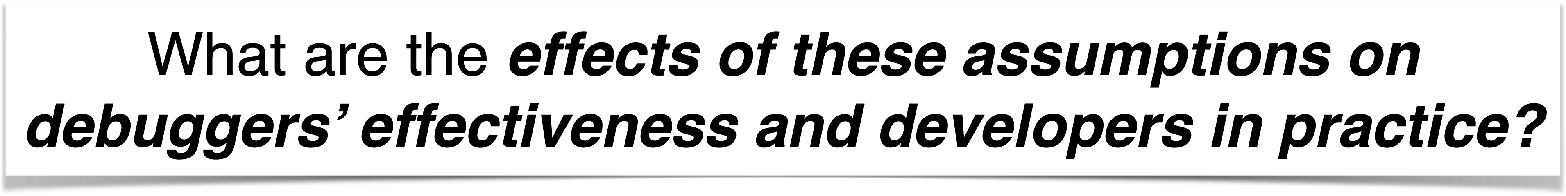
Experimental Factors
Researchers assume that locating
and examining a single (first) faulty
program statement, out of several
faulty statements, is sufficient to
explain and fix the bug
In the absence of ground truth fault
locations, i.e., root cause location,
it is common to use fix locations
as substitute fault locations
XXXXXXX
XXXXXX
XXXXXX
XXXXXXX
Perfect Bug Understanding (PBU)
Fix Location
Research
Laboratory
Researchers often assume that the diagnoses for a faulty
program lies in a single contiguous fault location, even
though in reality the bug diagnoses may lie in
multiple contiguous fault locations
XXXXXXX
XXXXXX
XXXXXX
XXXXXXX
Single Fault Location

Slide 5
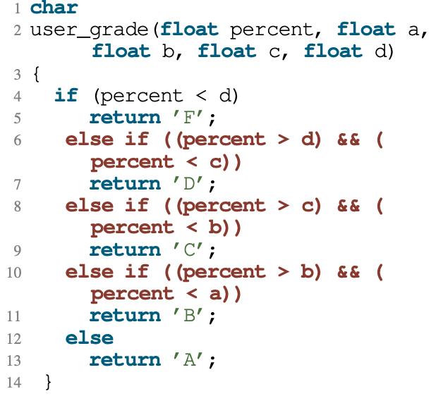
Single Fault Location
Single Fault Location
Diagnosis with Assumption:
Line 6 is faulty: The
“>” operator needs to be
changed to a “>=” operator
Researchers often assume that the diagnoses for a faulty
program lies in a single contiguous fault location, even
though in reality the bug diagnoses may lie in
multiple contiguous fault locations
Research
Laboratory
Multiple Fault Locations
Single Fault Location
Diagnosis without Assumption:
Lines 6, 8 and 10 are faulty:
All the “>” operators must be
changed to “>=” operators
Failing Test Case:
Method user grade returns “A” if the
grade is equal to one of the thresholds
Software Practice

Slide 6
Evaluation Methods
RQ1: Prevalence of Assumptions
RQ2: Impact on AFL Effectiveness
RQ3: Proxy Effect on APR Effectiveness
RQ4: Developers’
Productivity
Survey Analysis
(212 Papers & 352 Bugs)
Controlled Experiments
(19 AFL Methods)
Controlled Experiments
(GenProg & Angelix)
User Study
(76 Developers)

Slide 7
Prevalence in Debugging Literature (RQ1)
RQ1: Prevalence of Assumptions
Debugging assumptions are highly prevalent in the literature:
55% of experiments in the surveyed publications make at least one of the three (3) studied assumptions
Survey Analysis
(212 Papers)

Slide 8
Prevalence in Bug Datasets (RQ1)
RQ1: Prevalence of Assumptions
About half (49% of) the bugs in the bug datasets are impacted by at least one of the debugging assumptions
Survey Analysis
(352 Bugs)

Slide 9
AFL & APR Tools
RQ1: Prevalence of Assumptions
RQ2: Impact on AFL Effectiveness
RQ3: Proxy Effect on APR Effectiveness
RQ4: Developers’
Productivity
Survey Analysis
(212 Papers & 352 Bugs)
Controlled Experiments
(19 AFL Methods)
Controlled Experiments
(2 APR Tools)
User Study
(76 Developers)

Slide 10

Controlled Experimentation (Split Testing)
Single Fault Location
Diagnosis with Assumption:
Line 6 is faulty: The
“>” operator needs to be
changed to a “>=” operator
Research
Laboratory with Assumptions
Measured
Effectiveness
Automated Debugger
Automated Debugger
Multiple Fault Locations
Diagnosis without Assumption:
Lines 6, 8 and 10 are faulty:
All the “>” operators must be
changed to “>=” operators
Research
Laboratory without Assumptions
Software Practice
Measured
Effectiveness

Slide 11
Impact on AFL Effectiveness (RQ2)
RQ2: Impact on AFL Effectiveness
The studied debugging assumptions inflate the measured effectiveness of AFL techniques by up to 38%, on average.
Controlled Experiments
19 AFL Methods

Slide 12
Proxy Effect on APR Effectiveness (RQ3)
RQ3: Proxy Effect on APR Effectiveness
Debugging assumptions reduce the measured effectiveness of APR tools: 125% more repairs are generated without these assumptions with repair time being up to 3X higher
Controlled Experiments
2 APR Tools

Slide 13
Developers’ Productivity
RQ1: Prevalence of Assumptions
RQ2: Impact on AFL Effectiveness
RQ3: Proxy Effect on APR Effectiveness
RQ4: Developers’
Productivity
Survey Analysis
(212 Papers & 352 Bugs)
Controlled Experiments
(19 AFL Methods)
Controlled Experiments
(2 APR Tools)
User Study
(76 Developers)

Slide 14
User Study Settings
Subjects
RQ4: Developers’
Productivity
8 Buggy
Programs
16 Debugging Sessions
76 Professional Developers
Metrics
User Study
Usefulness and Closeness
Developers’ Preference
Severity and
Soundness

Slide 15
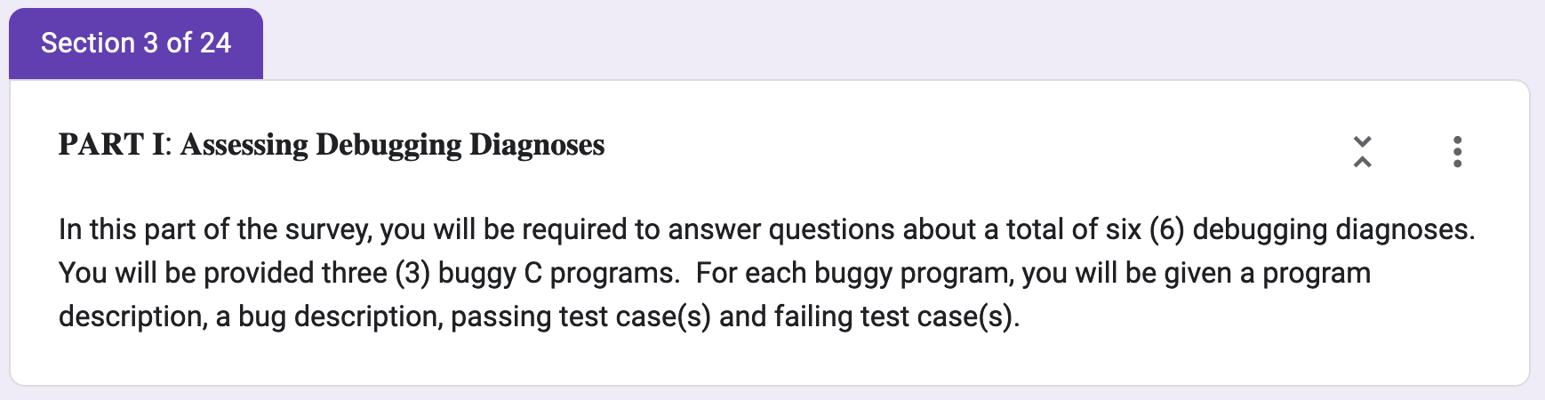
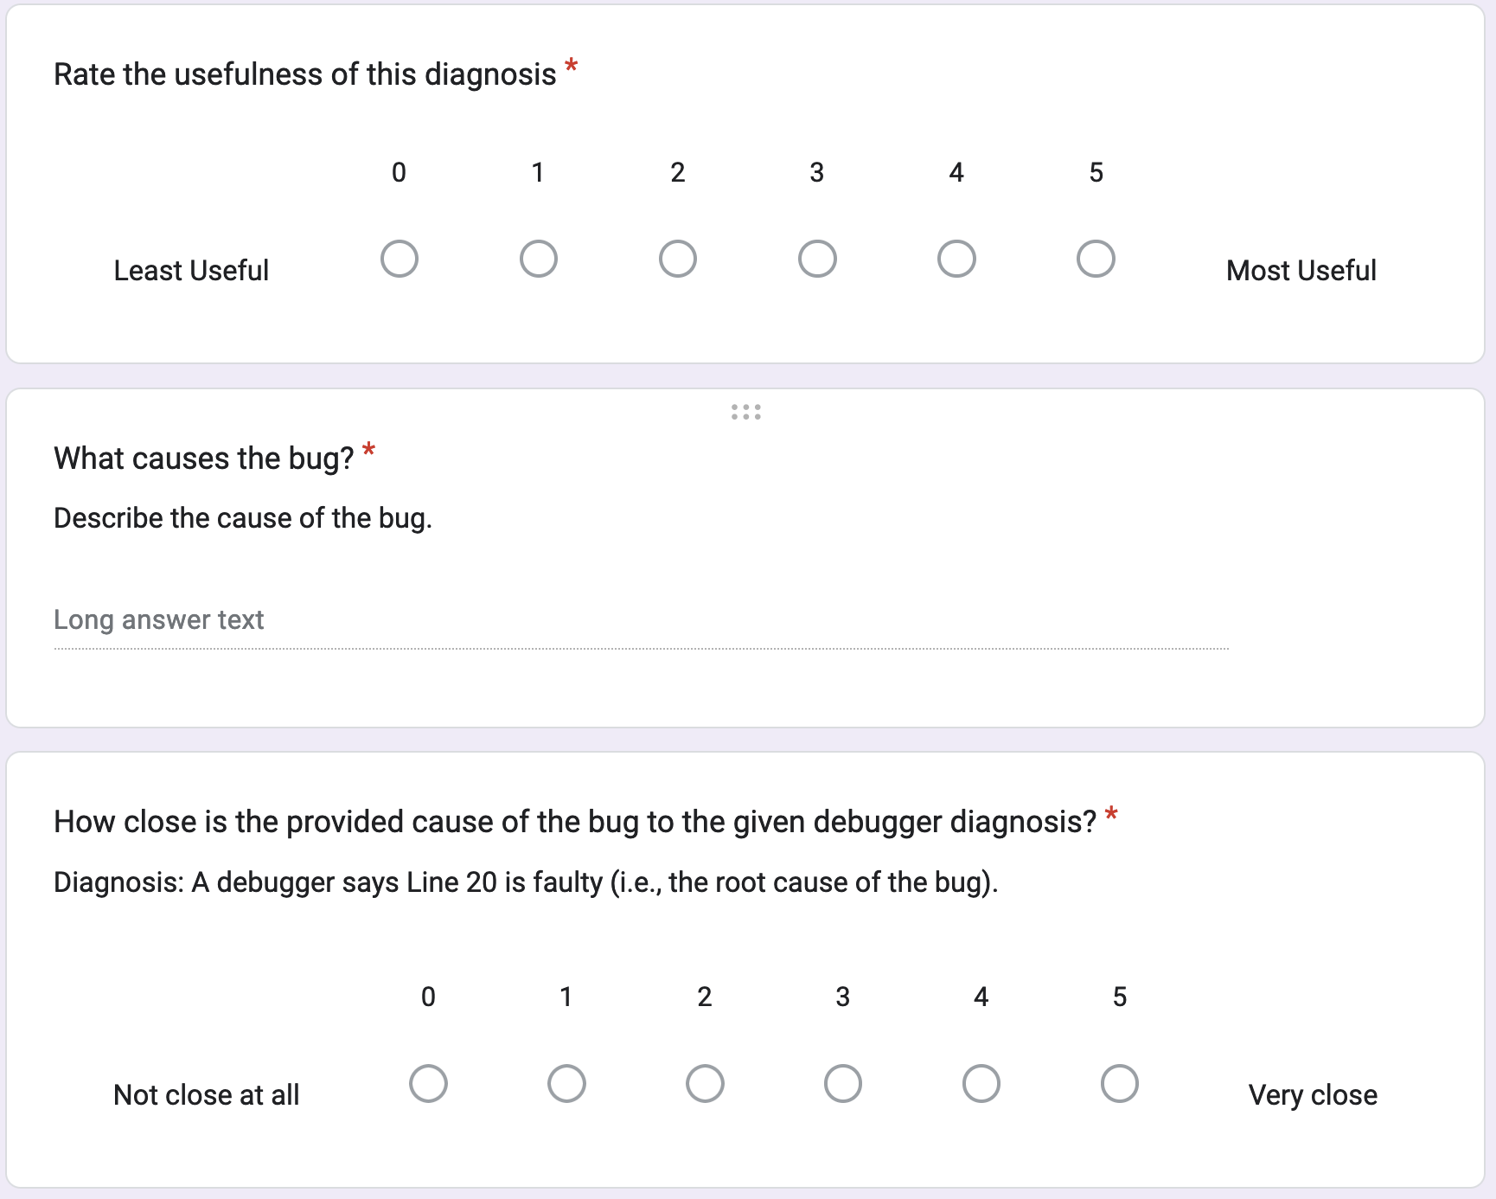

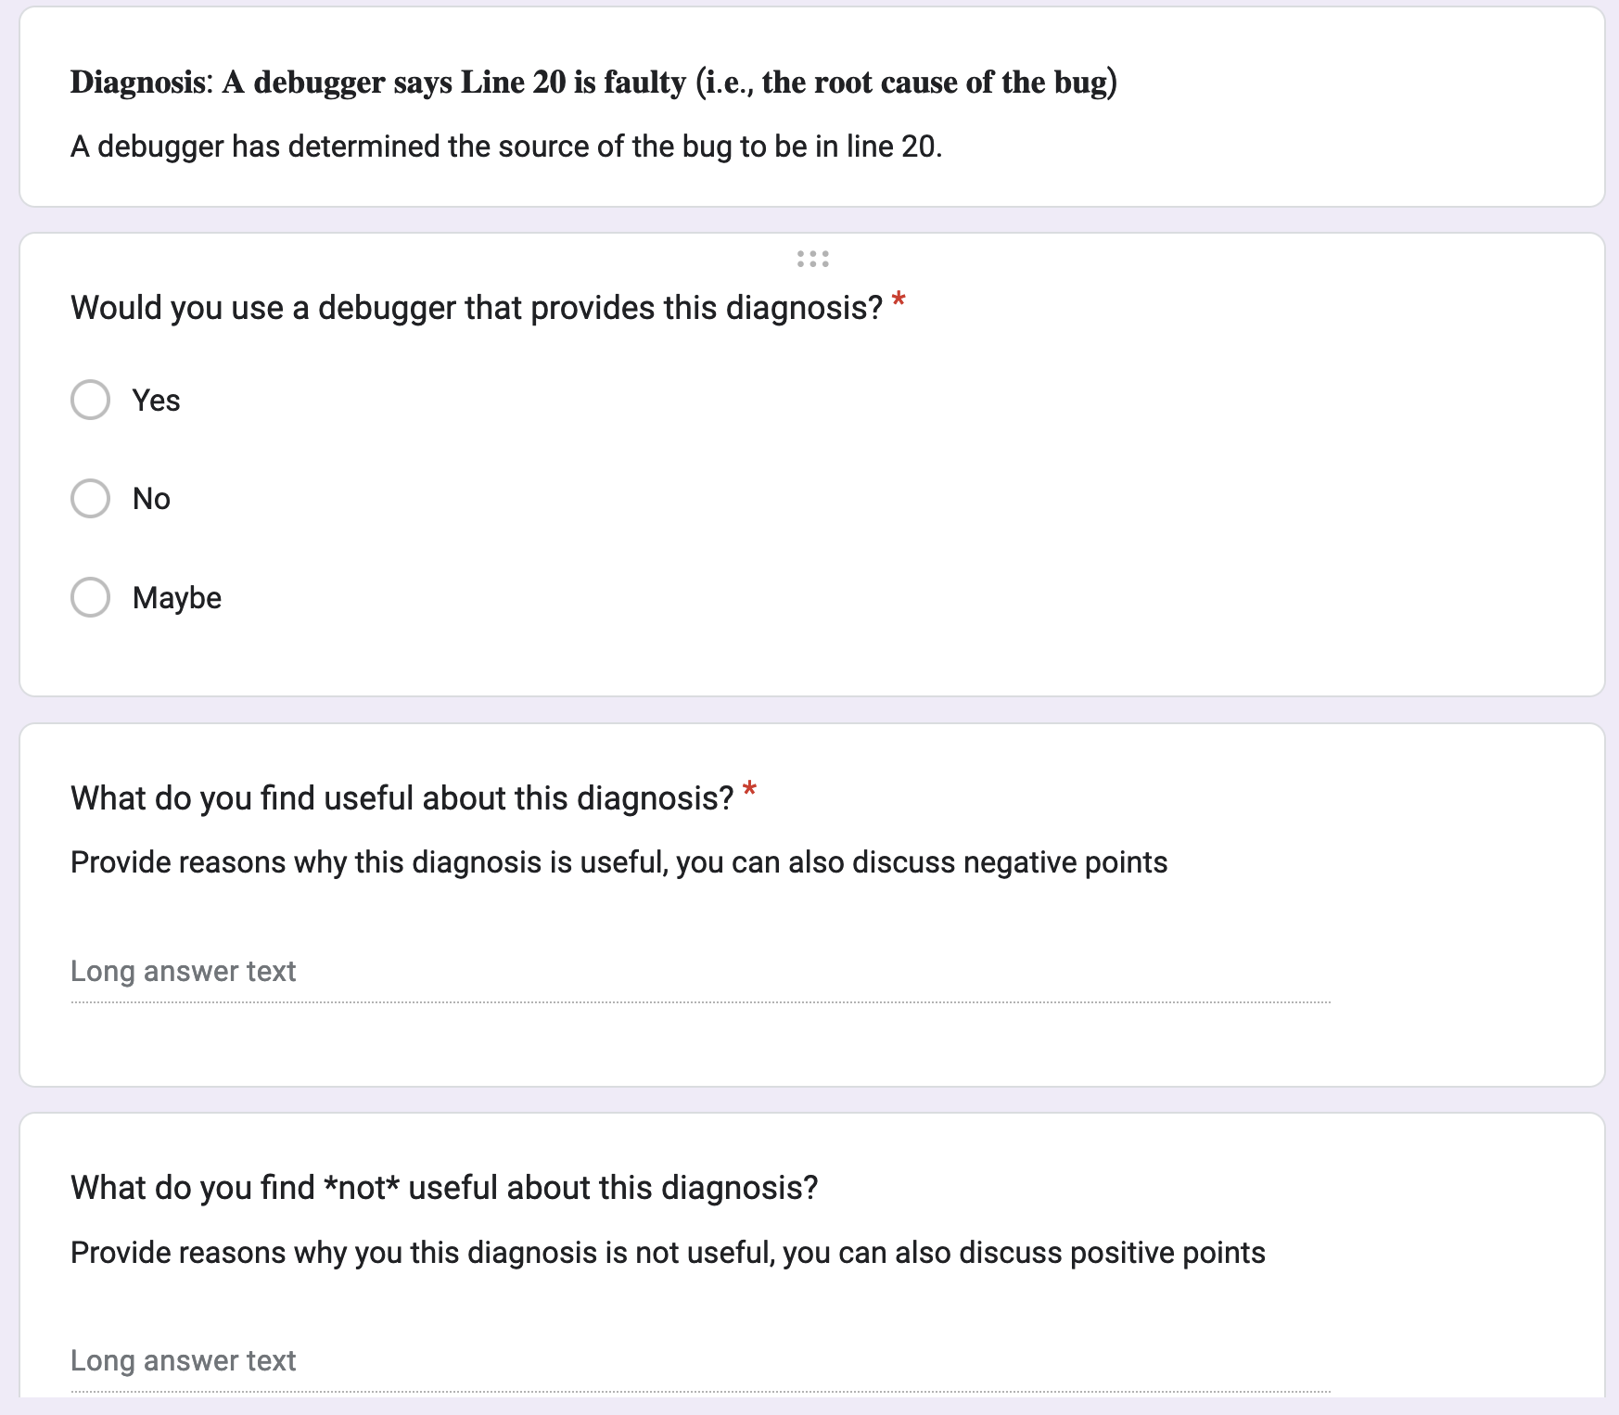



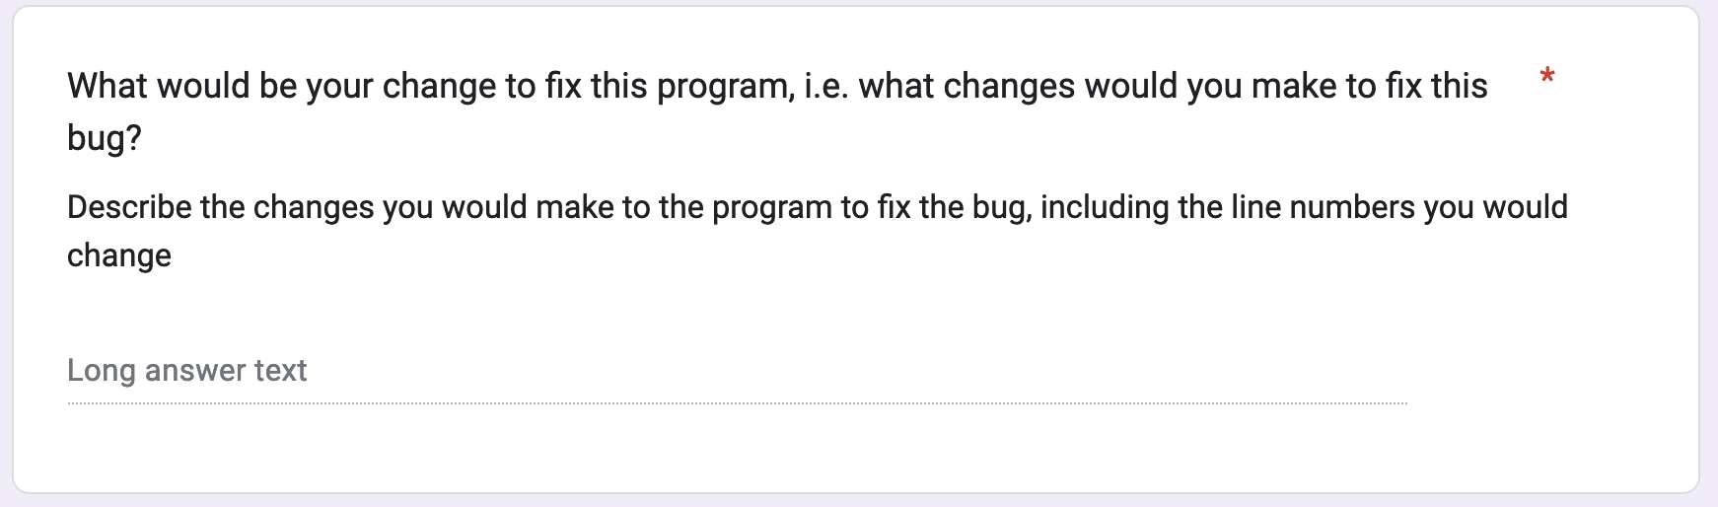
User Study Questionnaire
Usefulness and Closeness

Slide 16
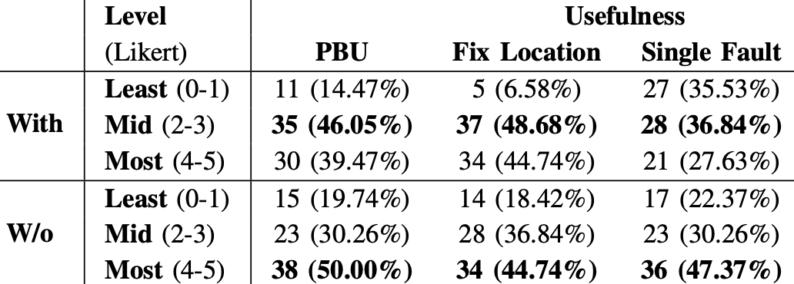
Usefulness to Developers
Usefulness and Closeness
Majority of developers (80%) found diagnoses provided without the assumptions are considered mid to most useful

Slide 17
Developers’ Preference
Developers’ Preference
Developers preferred debugging diagnoses without the assumption than the diagnosis provided with the assumption

Slide 18
Are Assumptions Realistic in Practice?
Assumptions do
“not provide enough [debugging] information”
“waste [developer] time”
Assumptions lead to
inadequate debugging information
wrong diagnosis
Severity and
Soundness
Most developers (60%) believe these three assumptions are unrealistic in practice because they lead to imprecise, wrong or inadequate bug diagnoses

Slide 19
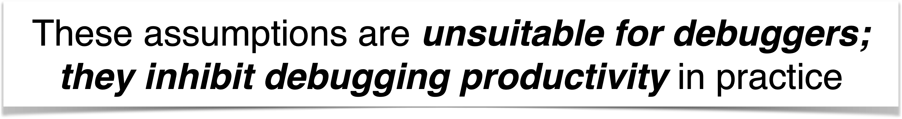
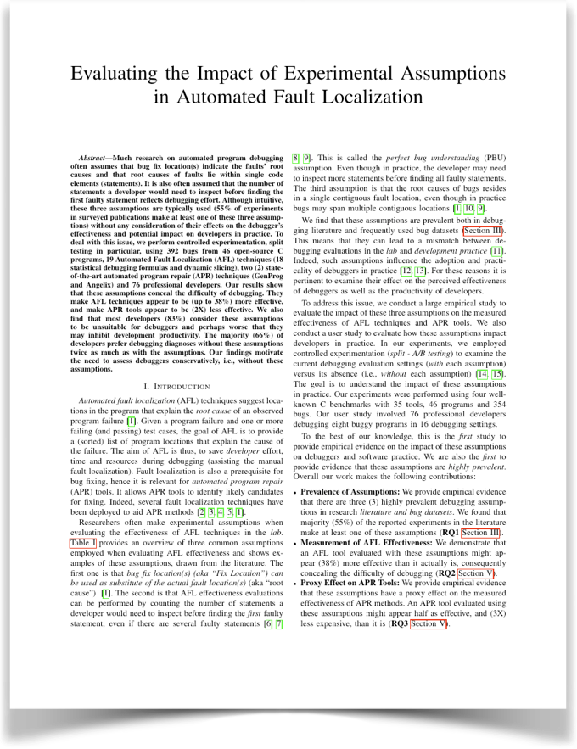

Lessons Learned
RQs
Results
Prevalence
Most (55% of) experiments in the literature
make at least one of these three assumptions
Impact on AFL
Effectiveness
Assumptions conceal debugging difficulty make AFL appear to be (38%) more effective
Proxy Effect on
APR Effectivness
These assumptions make APR techniques
appear to be (2X) less effective
Impact on
Developers
Most (66% of) developers prefer debugging fault
diagnoses without these assumptions

Slide 20
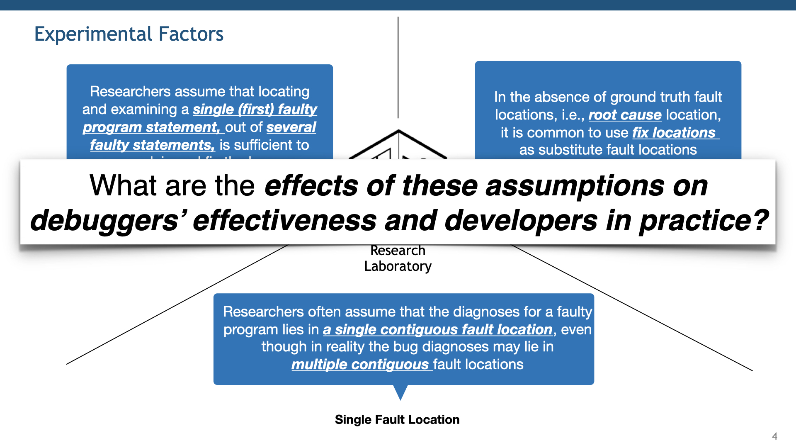
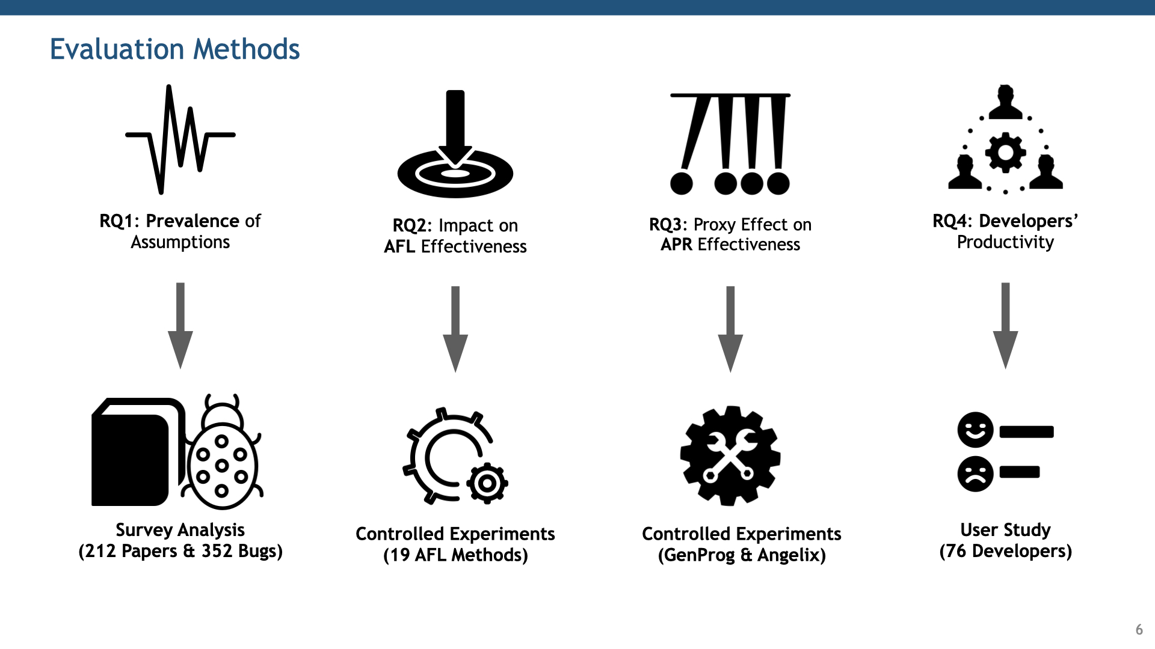

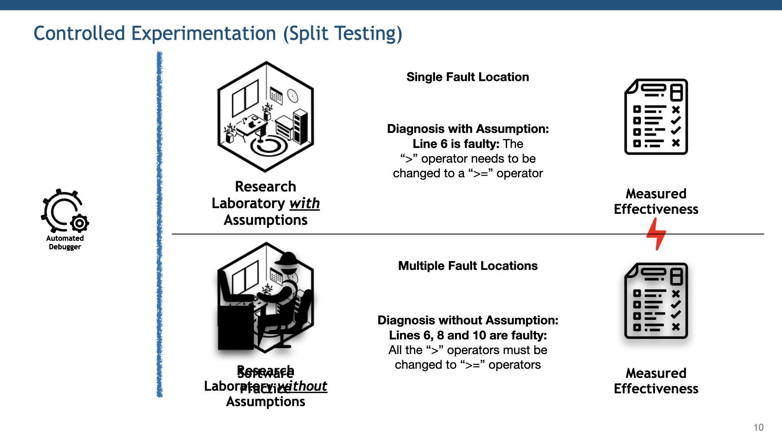
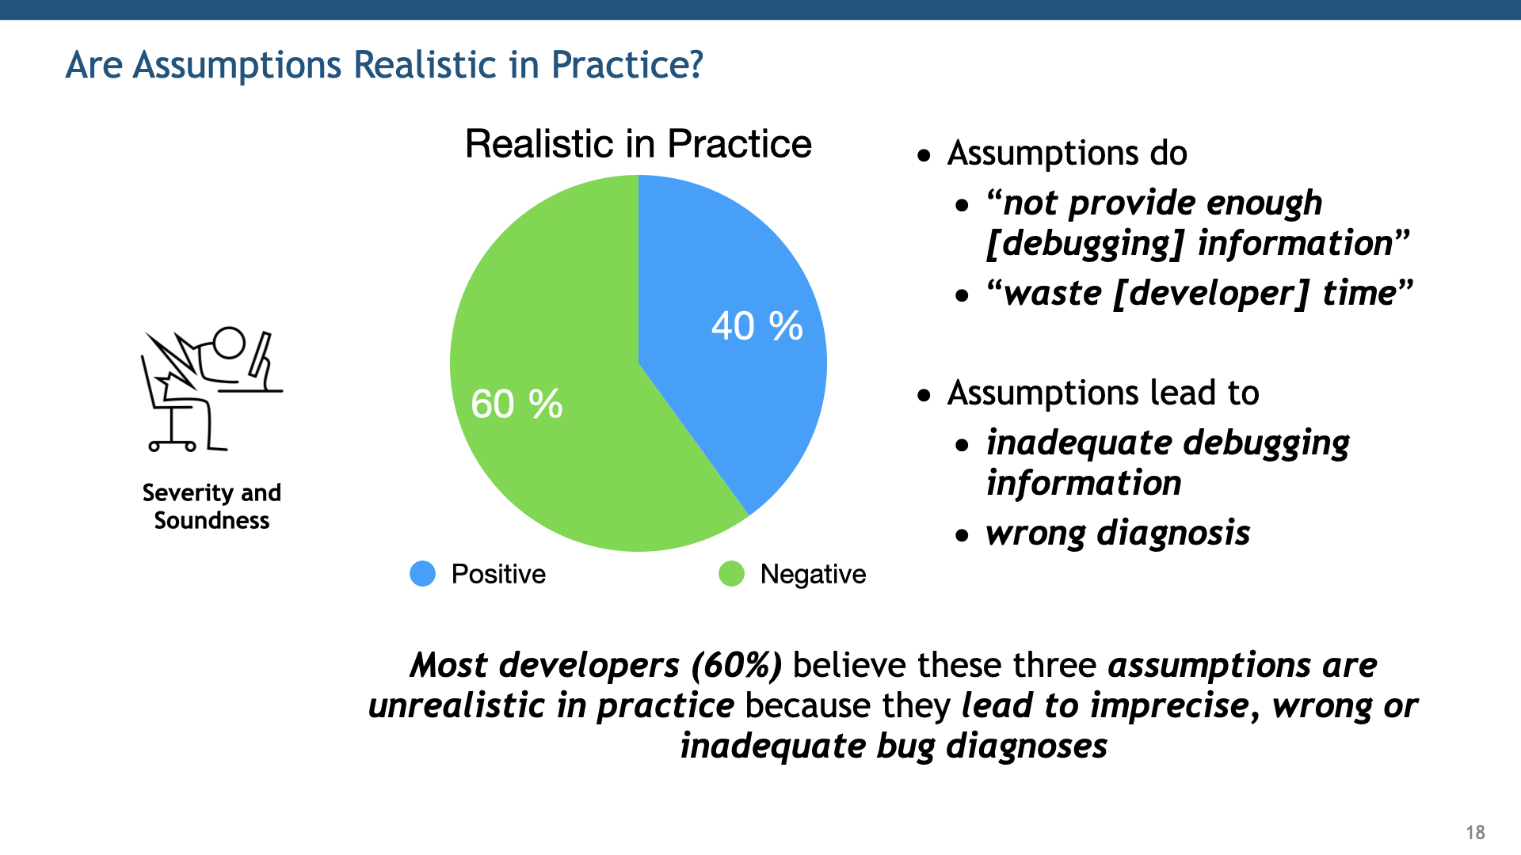

Slide 21
Appendix

Slide 22
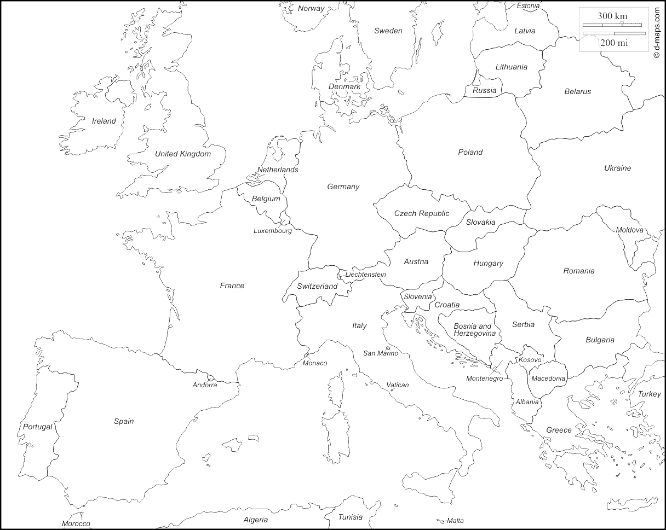

Ezekiel Soremekun
Lecturer (Asst. Prof.)
RHUL, UK
Research Scientist
SnT, Luxembourg

Slide 23
Problem
Automated Debugger
Research
Laboratory
Software Practice
There is a chasm between the state of debugging research and software practice

Slide 24
Experimental Factors
Researchers assume that locating
and examining a single (first) faulty
program statement, out of several
faulty statements, is sufficient to
explain and fix the bug
Perfect Bug Understanding (PBU)
Research
Laboratory

Slide 25
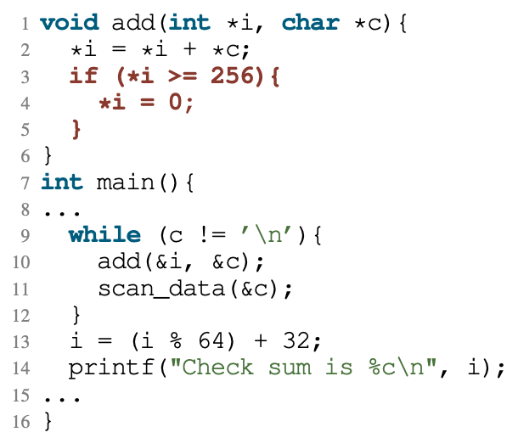
Perfect Bug Understanding
Perfect Bug Understanding (PBU)
Diagnosis with PBU:
The fault localization points
to line 3 as the faulty location,
since the “if” statement is wrong.
Researchers assume that locating
and examining a single (first) faulty
program statement, out of several
faulty statements, is sufficient to
explain and fix the bug
Research
Laboratory
No Perfect Bug Understanding (PBU)
Perfect Bug Understanding (PBU)
Diagnosis without PBU:
Lines 3, 4 and 5 are chosen
as faulty lines by the AFL tool
since the “if” statement needs
to be deleted to fix the bug.
Failing Test Case:
The program outputs the same
checksum for ‘‘zzz’’ and ‘‘zzx’’
Software Practice

Slide 26
Experimental Factors
Researchers assume that locating
and examining a single (first) faulty
program statement, out of several
faulty statements, is sufficient to
explain and fix the bug
In the absence of ground truth fault
locations, i.e., root cause location,
it is common to use fix locations
as substitute fault locations
XXXXXXX
XXXXXX
XXXXXX
XXXXXXX
Perfect Bug Understanding (PBU)
Fix Location
Research
Laboratory

Slide 27
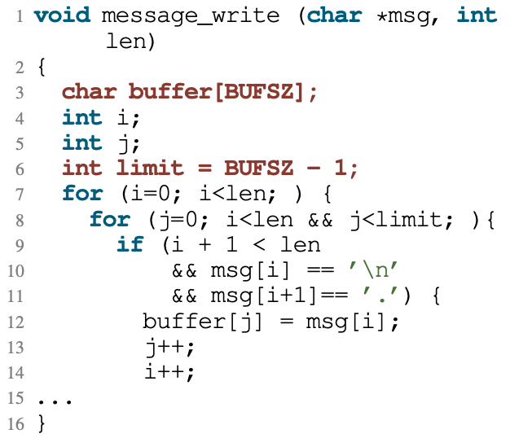
Fix Location (vs. Root Cause Location)
Fix Location
Diagnosis with Fix Location:
Line 6 is faulty: If 4 is subtracted
from the limit, the buffer overflow
does not occur anymore
In the absence of ground truth fault
locations, i.e., root cause location,
it is common to use fix locations
as substitute fault locations
Research
Laboratory
Root Cause Location
Fix Location
Diagnosis with Root Cause:
Line 3 is faulty: The buffer needs
to be allocated large enough to
accommodate the whole string.
Failing Test Case:
A buffer overflow occurs for strings
of a certain length ending with ’\n’
Software Practice

Slide 28
Experimental Factors
Researchers assume that locating
and examining a single (first) faulty
program statement, out of several
faulty statements, is sufficient to
explain and fix the bug
In the absence of ground truth fault
locations, i.e., root cause location,
it is common to use fix locations
as substitute fault locations
XXXXXXX
XXXXXX
XXXXXX
XXXXXXX
Perfect Bug Understanding (PBU)
Fix Location
Research
Laboratory
Researchers often assume that the diagnoses for a faulty
program lies in a single contiguous fault location, even
though in reality the bug diagnoses may lie in
multiple contiguous fault locations
XXXXXXX
XXXXXX
XXXXXX
XXXXXXX
Single Fault Location

Slide 29
Experimental Factors
Researchers assume that locating
and examining a single (first) faulty
program statement, out of several
faulty statements, is sufficient to
explain and fix the bug
In the absence of ground truth fault
locations, i.e., root cause location,
it is common to use fix locations
as substitute fault locations
XXXXXXX
XXXXXX
XXXXXX
XXXXXXX
Perfect Bug Understanding (PBU)
Fix Location
Research
Laboratory
Researchers often assume that the diagnoses for a faulty
program lies in a single contiguous fault location, even
though in reality the bug diagnoses may lie in
multiple contiguous fault locations
XXXXXXX
XXXXXX
XXXXXX
XXXXXXX
Single Fault Location

Slide 30
Research Questions
RQ1: Prevalence of Assumptions
RQ2: Impact on AFL Effectiveness
RQ3: Proxy Effect on APR Effectiveness
RQ4: Developers’
Productivity

Slide 31
Prevalence Setup (Literature)
RQ1: Prevalence of Assumptions
212 publications (from 2017 to June 2022)
13 keywords (IEEE Standard Glossary of SE Terminology)
E.g., “debug”, “fix”, “repair”, “fault”, etc.
Survey Analysis
(212 Papers)

Slide 32
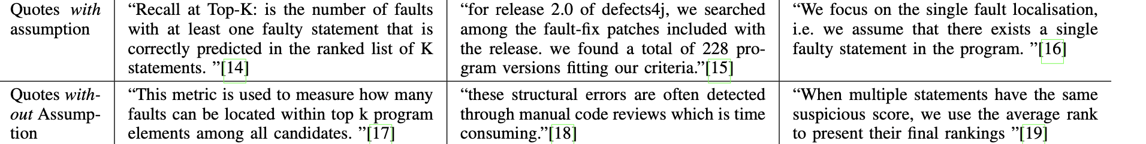
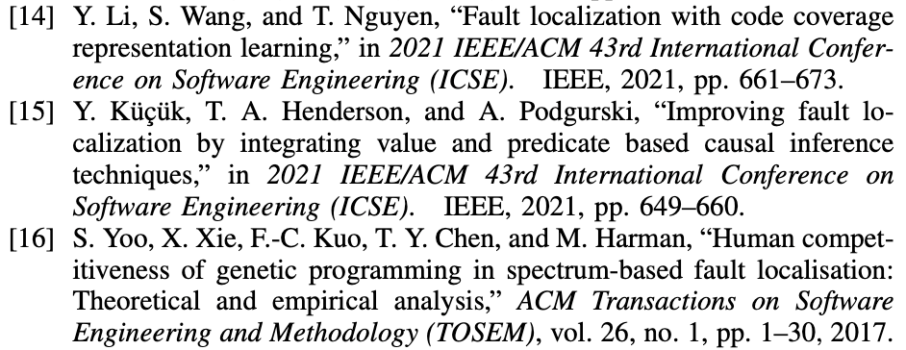
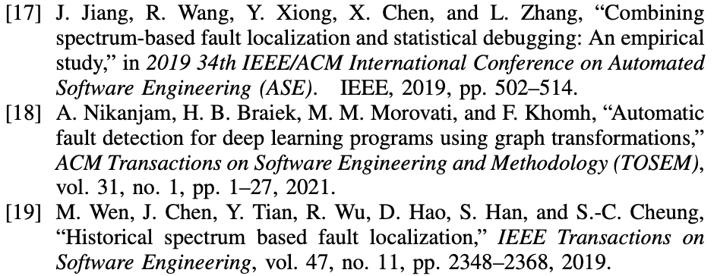
Experimental Assumptions in the Literature

Slide 33
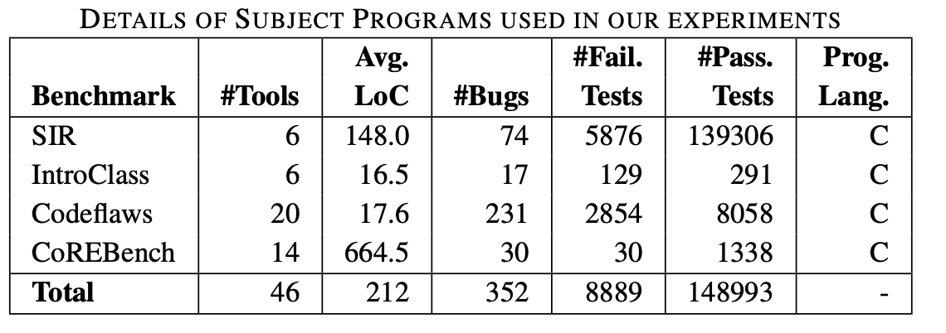
Prevalence Setup (Bug Datasets)
RQ1: Prevalence of Assumptions
352 bugs with different types of bugs and varying complexity
4 bug datasets (popular benchmarks):
CoreBench, Siemens SIR, IntroClass & Codeflaws
Survey Analysis
(352 Bugs)

Slide 34
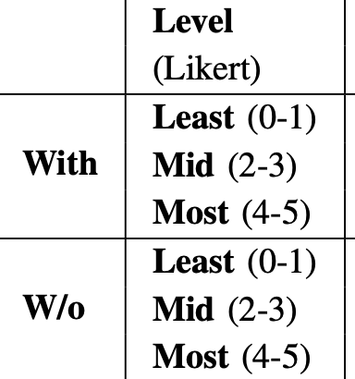
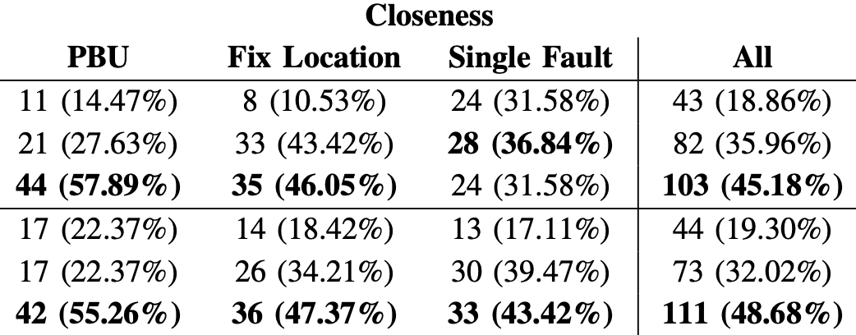


Closeness to Developers’ Perfect Diagnosis
Usefulness and Closeness
Diagnoses provided without the assumptions are the closest to developer’s own perfect diagnosis

Slide 35
Controlled Experimentation (Split Testing)
Perfect Bug Understanding (PBU)
Diagnosis with PBU:
The fault localization points
to line 3 as the faulty location,
since the “if” statement is wrong.
Research
Laboratory with Assumptions
Measured
Effectiveness
Automated Debugger
Automated Debugger
No Perfect Bug Understanding (PBU)
Diagnosis without PBU:
Lines 3, 4 and 5 are chosen
as faulty lines by the AFL tool
since the “if” statement needs
to be deleted to fix the bug.
Research
Laboratory without Assumptions
Software Practice
Measured
Effectiveness

Slide 36
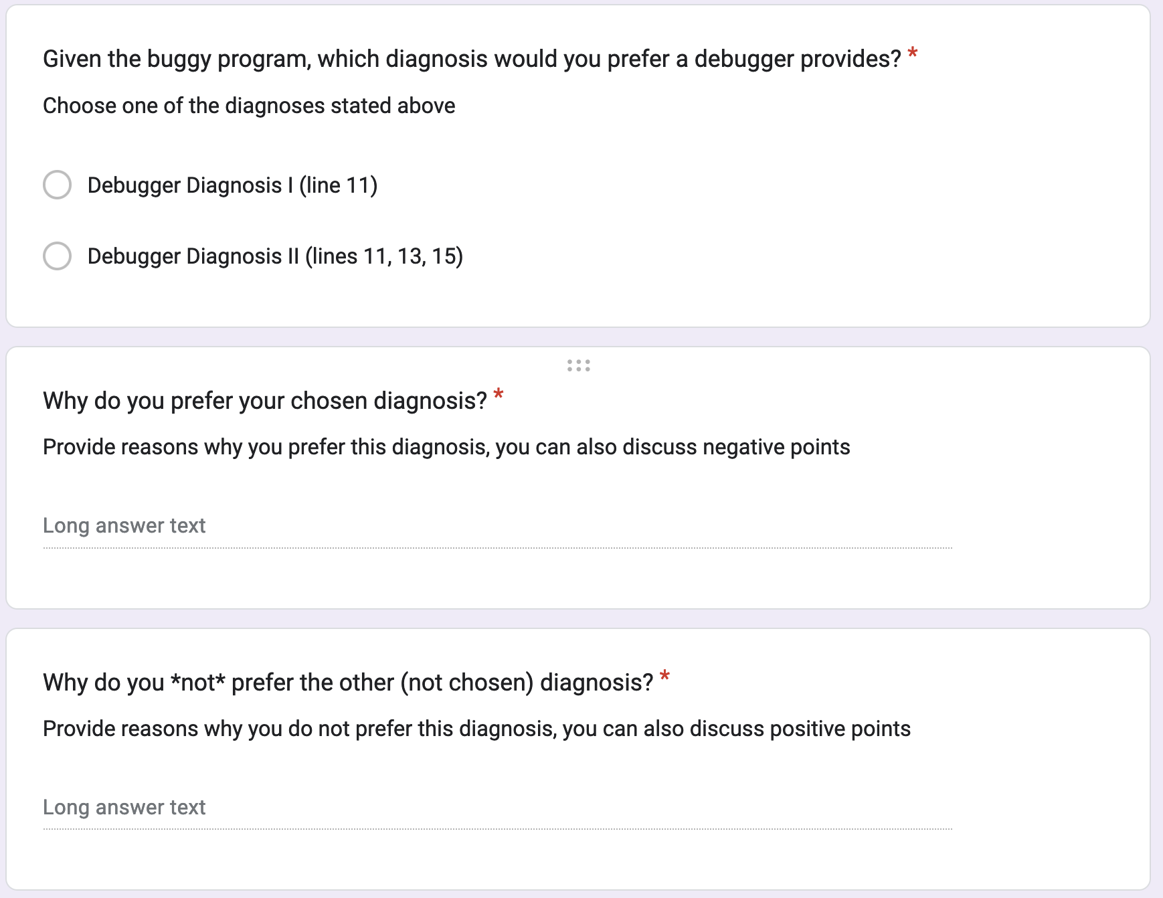
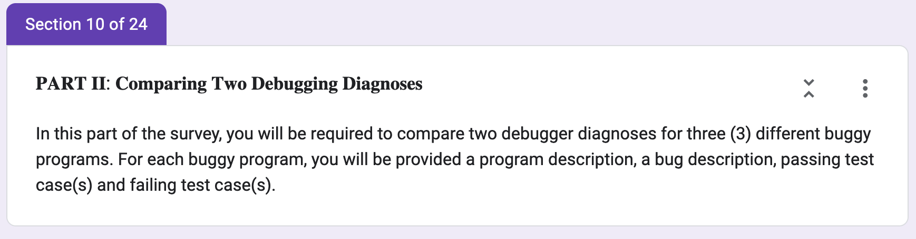

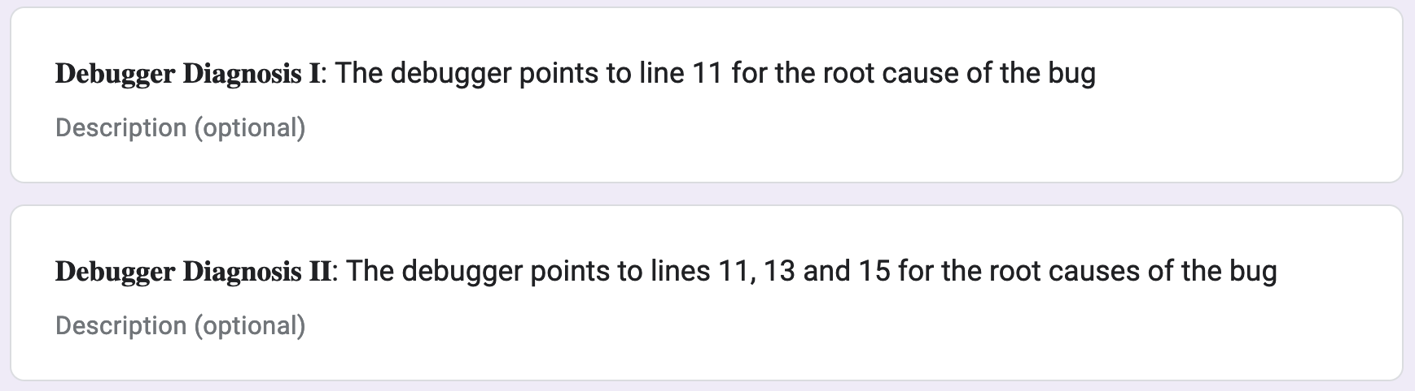
User Study Questionnaire
Developers’ Preference

Slide 37
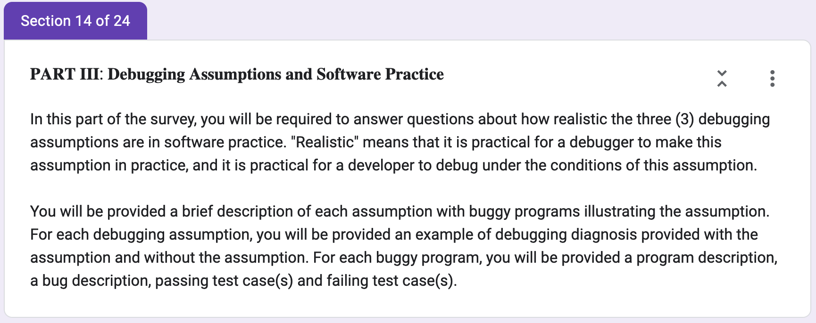
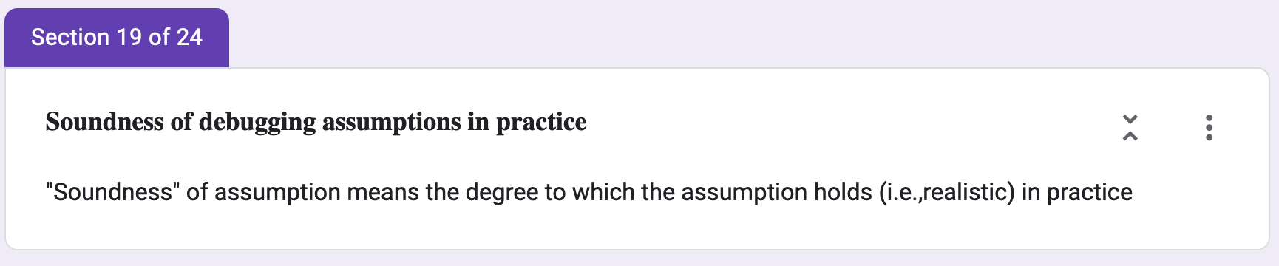
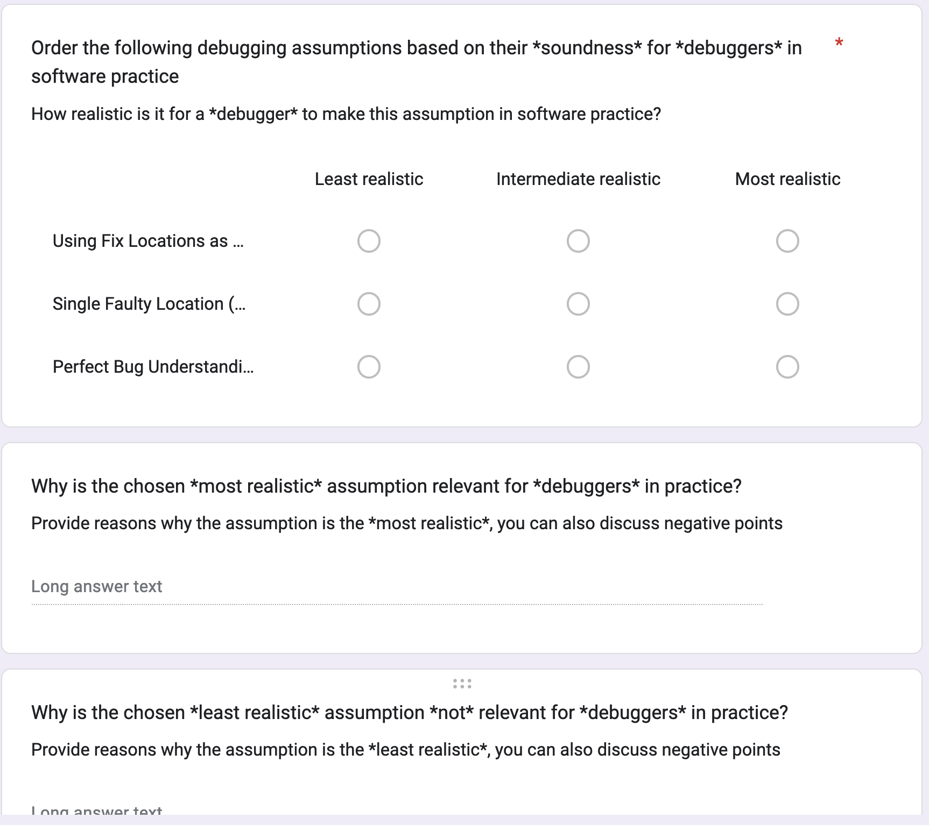
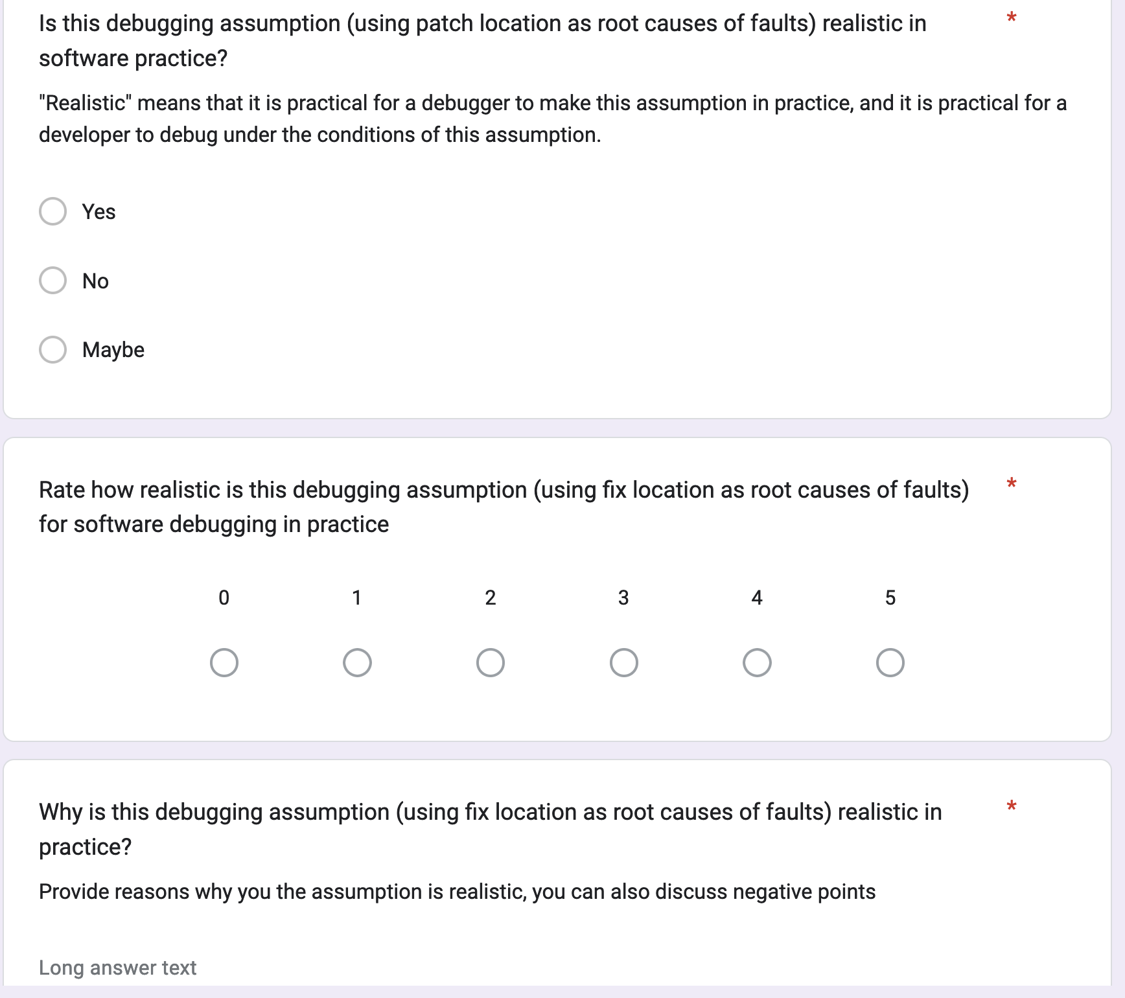

User Study Questionnaire
Severity and
Soundness

Slide 38
Soundness and Severity
Severity and
Soundness
Two-fifth (38%) of developers found the most prevalent “fix location” assumption to be the least sound for debuggers and most severe on developer productivity

Slide 39

Future Work
Challenges
Learn
Debugging
Evaluation
How developers debug and fix bugs? A developer-
centric bug benchmark (DBGBENCH) [FSE 17]
AFL
Effectiveness
Real-world effectiveness of 19 SOTA AFL methods to
inform better, more effective hybrid methods [EMSE 21]
Experimental
Factors
Assumptions about debugging settings impact AFL, APR and Developer efficacy [ICSE 23]
Software
Practice
Tools
Support
How to evaluate AFL/APR tools with developers
in real-world development settings?
Practical
Integration
How to effectively integrate debuggers into
software development settings (e.g., Fuzzing CIs)?

